Slide 1
Predicting a Patient’s Financial Risk
Group 7- Husain Ali, Michael Kolandjian, Emily Thamm, & Arushi Varshney

Slide 2
Agenda
Predictive problem overview
Dataset Analysis
Variable Selection
Models
Model Comparison
Conclusion
Notes:
emily

Slide 3
What is the financial risk of a patient?
Hospitals will be able to forecast patient’s total bill prior to treatment
Insurance companies will be able to ensure a patient’s insurance plan is adequate
Notes:
Michael

Slide 4

Dataset Analysis
Texas Department of State Health Services - Hospital Discharge Dataset
740,817 records
194 variables
Hospital type, total charges, length of stay, insurance coverage, age, ethnicity, day of the week, patient status, and a variety of diagnoses/admittance codes
Notes:
Emily

Slide 5
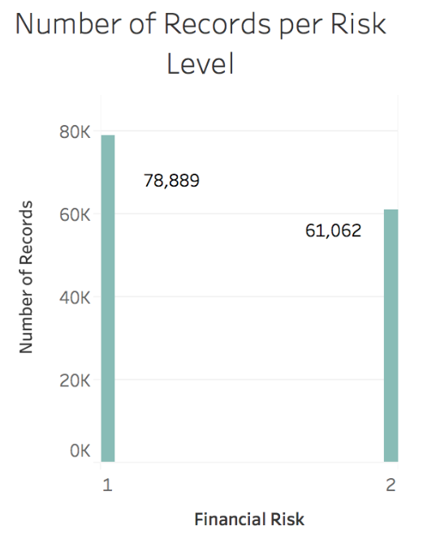
Data Preparation
Removed blank cells and invalid
Deleted all non-Texas patient records
Removed hospital specific variables
Dummy variables for Sex category
Transformed Age from 21 to 11 more inclusive categories
Created Discharged binary variable (discharged or expired in hospital)
Created financial risk variable based on total charges
From 740,817 to 139,951 records
Notes:
Emily

Slide 6
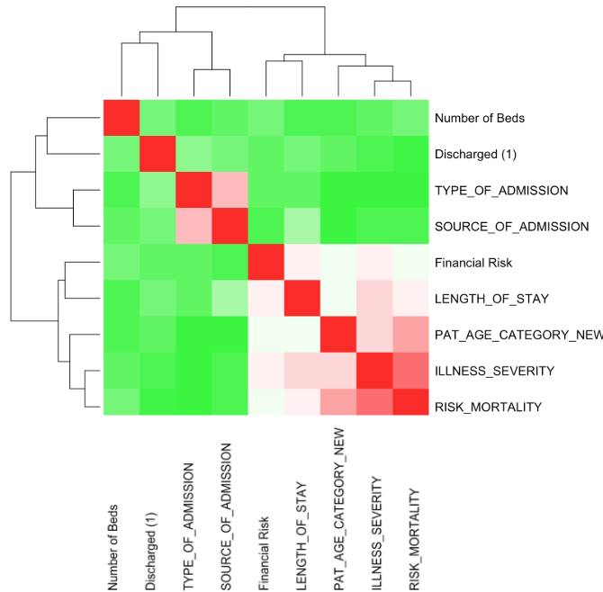
Variable Selection
Correlation Matrix
Illness Severity & Risk Morality
Type of Admission & Source of Admission
Notes:
Emily

Slide 7
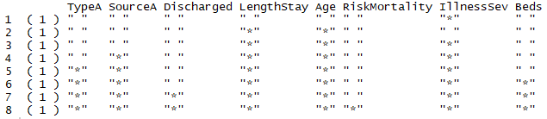
Variable Selection cont.
Forward Stepwise Selection
Backward Stepwise Selection
Stepwise Selection
Notes:
Emily

Slide 8
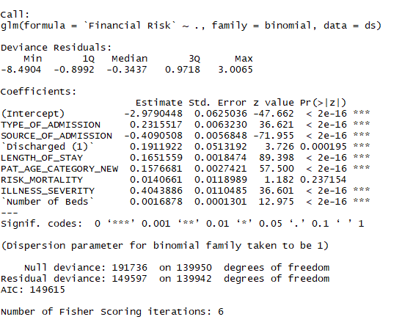

Model 1 - Logistic Regression
Financial Risk | Prediction
 |  | 0 | 1
 | 0 | 12,568 | 3,189
 | 1 | 5,026 | 7,298
Accuracy: .7066
Misclassification: .2934
Notes:
Husain

Slide 9
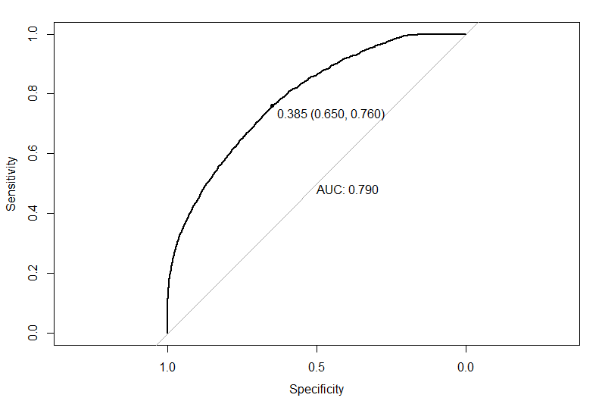

Model 1 - Logistic Regression
Financial Risk | Prediction
 |  | 0 | 1
 | 0 | 12,680 | 3,184
 | 1 | 4,895 | 7,232
Accuracy: .7114
Misclassification: .2886
Notes:
Husain

Slide 10
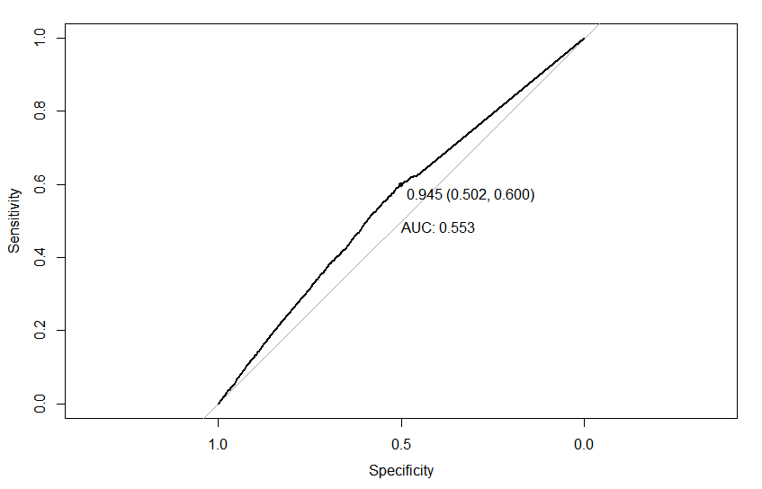

Model 2 - KNN
Financial Risk | Prediction
 |  | 0 | 1
 | 0 | 34,799 | 5,995
 | 1 | 4,683 | 24,498
Confusion Matrix for k=10
Accuracy: .8474
Misclassification: .1526
Notes:
Husain

Slide 11
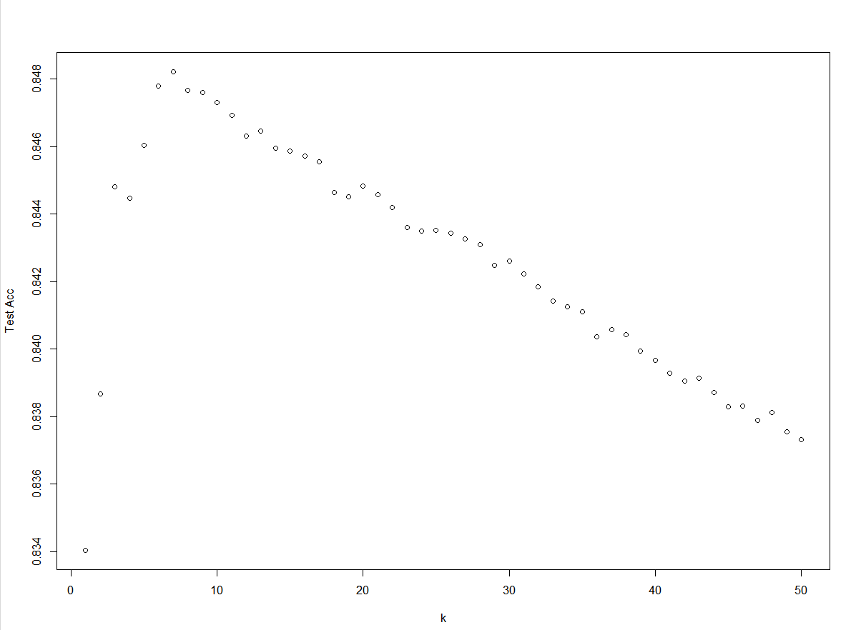
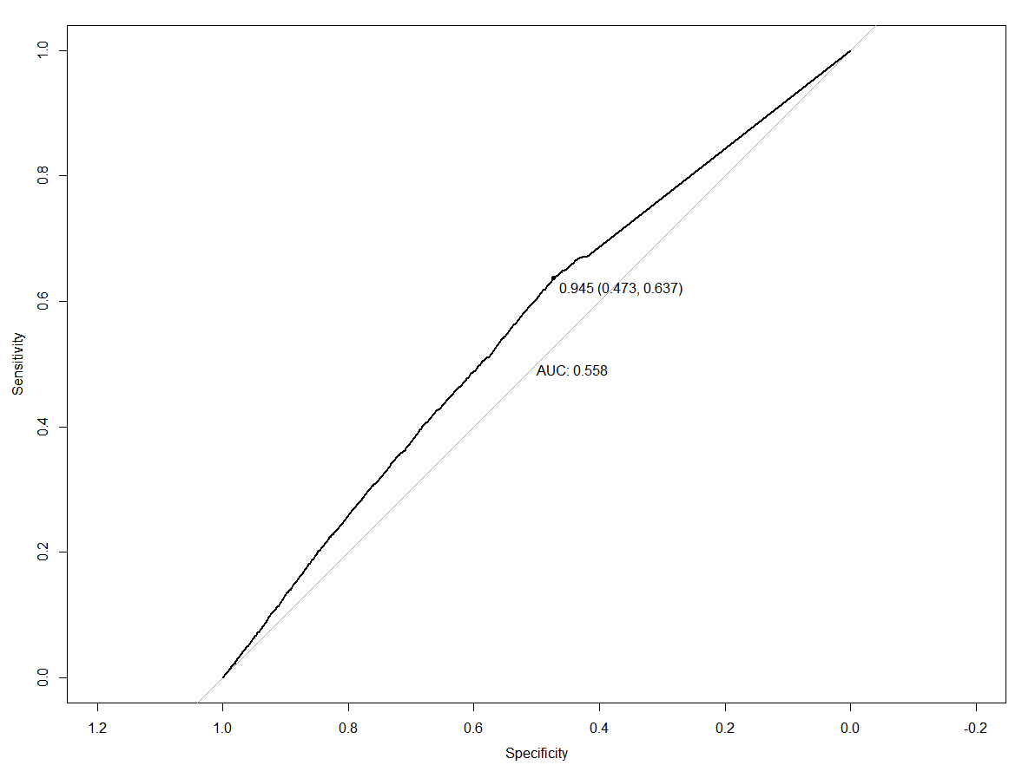
Model 2 - KNN cont.
Financial Risk | Prediction
 |  | 0 | 1
 | 0 | 34,776 | 5,898
 | 1 | 4,706 | 24,595
Highest accuracy of 85% at k = 7
Confusion Matrix for k=7
Accuracy: .8485
Misclassification: .1515
Notes:
Husain

Slide 12
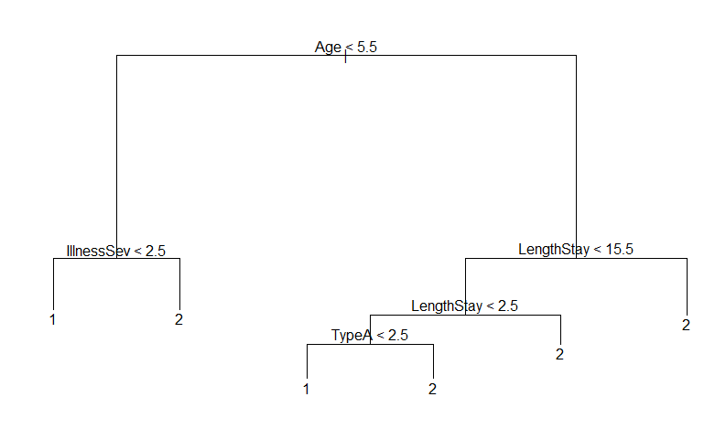
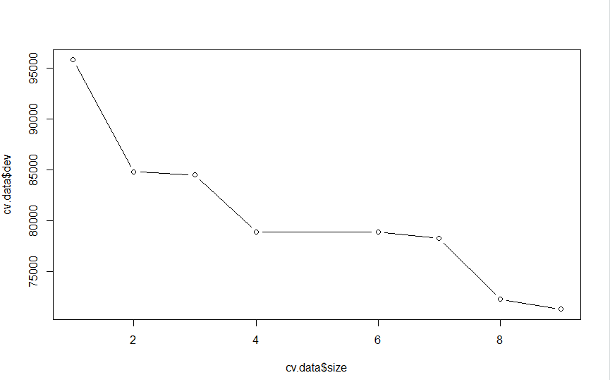
Model 3 - Decision Tree
Financial Risk | Prediction
 |  | 0 | 1
 | 0 | 27,235 | 6,254
 | 1 | 12,083 | 24,403
Cost Complexity Analysis
9 leaves give lowest deviance
8 is simpler model with only slightly higher deviance
Accuracy: .7379
Misclassification: .2621
Notes:
Michael

Slide 13
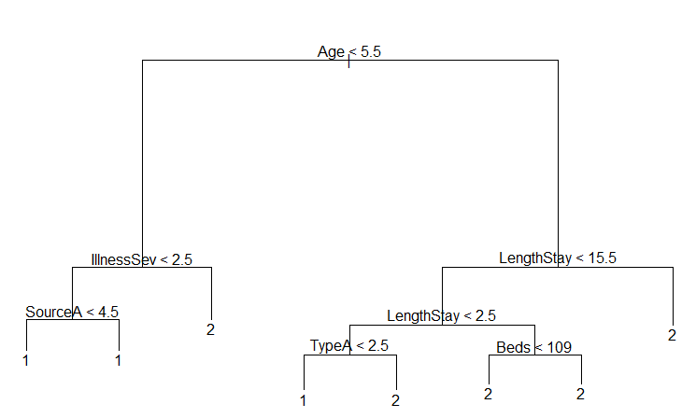
Model 3 - Decision Tree cont.
-Pruned to 8 to avoid overfitting
Financial Risk | Prediction
 |  | 0 | 1
 | 0 | 27,432 | 6,458
 | 1 | 11,886 | 24,199
Accuracy: .7378
Misclassification: .2621
Notes:
Michael

Slide 14
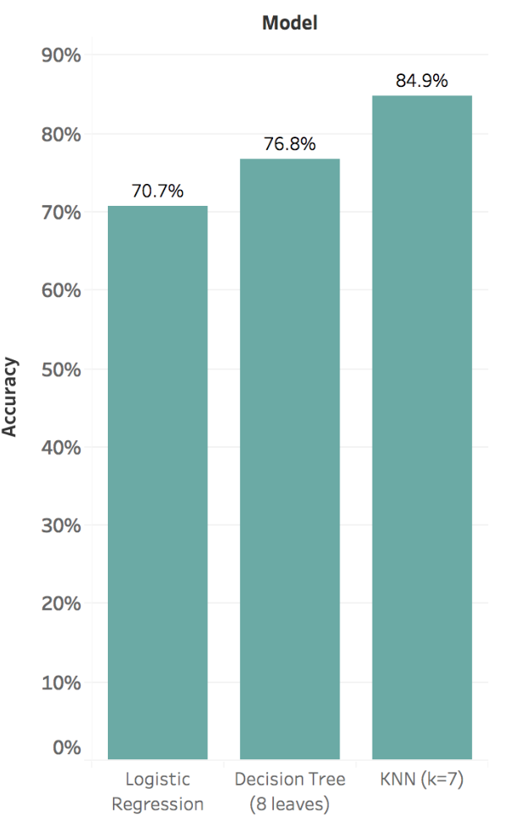
Model Comparison
Logistic regression had lowest accuracy
KNN (k=7) had the highest accuracy
Can consider Decision tree because of its good interpretability
Results were consistent across test and training
Notes:
Arushi

Slide 15
Conclusion
Age, illness severity and length of stay were the most important predictors
Benefits hospitals & healthcare companies
Identify future high cost patients and target these to improve care for these individuals
Provide critical Insights to reduce healthcare costs
Lower health expenditures when combined with appropriate interventions
Notes:
Arushi

